Slide 1

For all purpose
THE
WATERFALL
MODEL
5 OCT 2023
SWARAJ ANDHALE

Slide 2
OVERVIEW
The Waterfall Model is one of the oldest and most traditional methodologies for software development. It follows a sequential, linear approach where each phase must be completed before moving on to the next.
The Waterfall Model is a structured and documentation-heavy approach to software development that is effective when requirements are stable and well-defined.
2

Slide 3
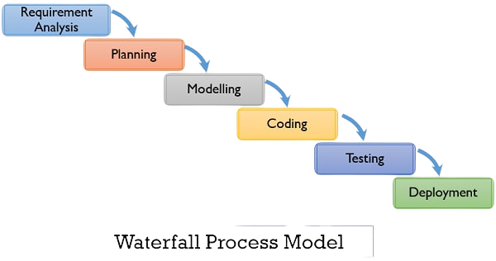
PHASES OF WATERFALL MODEL
5

Slide 4
PHASES OF WATERFALL MODEL
1. Requirements Gathering:
In this initial phase, the project team works closely with stakeholders to gather and document detailed project requirements.
The goal is to understand the client's needs and expectations for the software.
2. Planning:
During this phase, the project team creates a detailed system architecture and design based on the requirements gathered in the previous phase.
High-level and low-level design documents are produced to outline how the software will be structured and function.
.
5

Slide 5
PHASES OF WATERFALL MODEL
3. Implementation:
In the implementation phase, developers write the actual code for the software based on the design specifications.
This phase involves coding, unit testing, and ensuring that the software adheres to the design..
4. Testing:
Testing is a critical phase where the software is rigorously evaluated to ensure it meets the specified requirements.
Testing includes various levels such as system testing, integration testing, and user acceptance testing.
Defects and issues are identified and documented.
.
5

Slide 6
PHASES OF WATERFALL MODEL
5.Deployment:
After successful testing, the software is prepared for deployment to the end-users.
This phase involves installation, configuration, and any necessary data migration.
User training and documentation may also be provided to ensure a smooth transition to the new system.
6. Maintenance:
The maintenance phase occurs after the software has been deployed.
It involves ongoing support, bug fixing, updates, and enhancements to address issues and incorporate changes as needed.
Maintenance documentation is essential for tracking and managing changes.
.
5

Slide 7
ADVANTAGES OF WATERFALL MODEL
Clarity and Structure: The Waterfall Model provides a clear and well-defined structure for the entire software development process. Each phase has specific goals, deliverables, and criteria for completion, which helps in project planning and management.
Thorough Documentation: Rigorous documentation is a fundamental aspect of the Waterfall Model. Each phase produces detailed documentation, including requirements documents, design documents, and test plans.
Predictable Timelines: The sequential nature of the Waterfall Model makes it easier to estimate project timelines. Milestones are well-defined, allowing for better project management and resource allocation.
Quality Assurance: Each phase includes a testing component. By thoroughly testing each stage before moving to the next, the model helps in identifying and addressing issues early in the development process, leading to higher software quality.
5

Slide 8
DISADVANTAGES OF WATERFALL MODEL
Inflexibility to Changes: The Waterfall Model is highly sequential, and once a phase is completed, it is challenging and costly to make changes to earlier stages. This inflexibility can be a significant drawback when requirements evolve or are not well-understood initially.
Late Product Delivery: Clients often do not see a working version of the software until the end of the development process, after the entire project has been completed. This can lead to extended delivery times, and clients may only discover potential issues or discrepancies late in the project.
Limited Client Involvement: While clients or stakeholders are involved in the initial phases, their involvement decreases as the project progresses. This can result in reduced opportunities for client feedback and adjustments based on changing needs.
Risk of Misalignment: If client requirements are not accurately captured in the initial requirements gathering phase, there is a significant risk that the final product will not meet the client's actual needs.
5

Slide 9
CONCLUSION
In summary, while the Waterfall Model has been used successfully in many projects, it is best suited for situations where requirements are well-understood, stable, and unlikely to change significantly. For projects with evolving or uncertain requirements, or those that demand rapid adaptation, alternative development methodologies such as Agile may be more appropriate. Careful consideration of project requirements and constraints is essential when choosing a development approach.
5

Slide 10
THANK YOU
FOR
LISTENING

